Slide 1
Part 2:
Linear and logistic regression
Machine learning fundamentals

Slide 2
Lesson concepts
Linear regression:
Applying the theory of linear algebra and matrix operations to machine learning using linear regression
Univariate and multivariate regression
Using sklearn to train our first machine learning models, analyse the output and cast new predictions
Logistic regression and an introduction to performance metrics

Slide 3
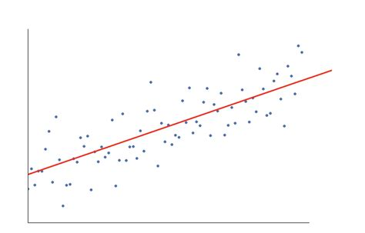
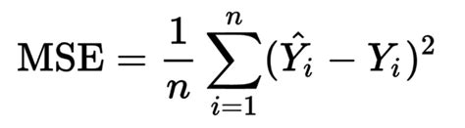
Time to really work your brains
If you have just one feature (X₁) and one dependent variable (y), both with 5 values, how could you translate the process of linear regression into matrix operations?
Features * coefficients (dot product)
x | 2 | 4 | 6 | 8 | 10
y | 8 | 14 | 20 | 26 | 32

Slide 4
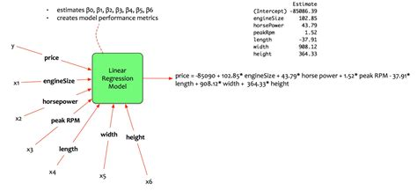
Multivariate linear regression
If you have just one feature (X₁) and one dependent variable (y), both with 5 values, how could you translate the process of linear regression training into matrix operations?

Slide 5
Using sklearn
We can:
Train a univariate/multivariate linear regression model
Find out how accurately the model learned to fit the data
See the weightings (value of m in y=mx+c) for each feature
Make predictions on new data points

Slide 6

Using sklearn
We can:
Train a univariate/multivariate linear regression model
Find out how accurately the model learned to fit the data
See the weightings (value of m in y=mx+c) for each feature
Make predictions on new data points
Let’s try it out!

Slide 7
Using sklearn
See weightings
How can we use information from the weightings (assume our model is working well) to derive further insight about our data?

Slide 8
Introduction to train test split
Just a basic mention of it

Slide 9
Pros of using linear regression
Pros:
Easy to apply and interpret
Handles small datasets well
Computationally efficient
When relationships with target variable are linear, this is a non-complex option
Gives you a valid, reliable baseline
Has effective regularization techniques to reduce overfitting

Slide 10
Cons of using linear regression
Cons:
Assumes linear relationships
Very sensitive to outliers
Assumes independent variables are not correlated
Simplistic for complex relationships

Slide 11
Classification
Recall what classification models do?
What would be the difference between binary and multi-class classification?
Can you think of an example of each?
Is classification a type of supervised or unsupervised learning?

Slide 12
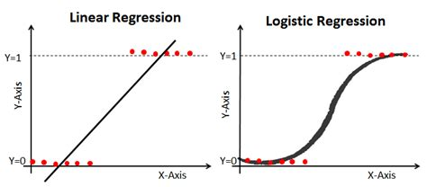
Classification - Logistic regression

Slide 13
Logistic regression
Don’t let ‘regression’ confused you, this is a classification task.
It models the probability of a certain class or event - e.g. the probability of someone paying their arrear.
We can then set thresholds for making a prediction, e.g. if probability > 0.5 then yes, else no.
In terms of process logistic is linear regression but with extra steps!

Slide 14
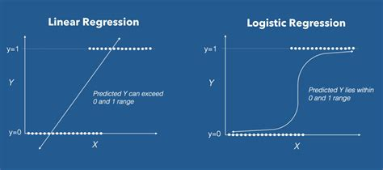
Logistic regression - differences to linear regression
Still carrying out linear regression and then applying the logistic function to fit the data better
Graph of linear -> logit

Slide 15
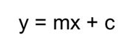
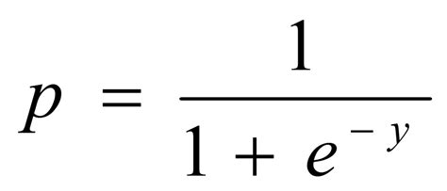
Logistic regression - Logit function
Constrains y to: 0 <= y <= 1 (transforms data from categorical to continuous)
Results in the sigmoidal shape
Turns out to be great for predicting class probabilities

Slide 16
Multinomial logistic regression
y = m₁x₁ + m₂x₂ + m₃x₃ + c
The exact same thing as before (linear eqn).
Takes output from linear eqn (log odds) and transforms it into probability by using the sigmoid function.

Slide 17
Model ‘learning’
At what point is our model actually ‘learning’?
Let’s consider each time the model ‘learns’ as a ‘lesson’
How many lessons should we allow our model to take?
‘Lessons’ = iterations

Slide 18
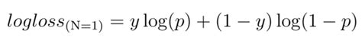
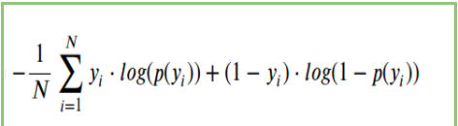
Logistic regression - differences to linear regression
Loss function - log loss
Explain what happens in this equation when y=0 and y=1
Notes:
For 0s you want prob lower which (when subtracted from 1 and becomes a high prob) yields a lower log
For 1s you want prob higher which yields a lower log
https://www.analyticsvidhya.com/blog/2020/11/binary-cross-entropy-aka-log-loss-the-cost-function-used-in-logistic-regression/

Slide 19
Logistic regression
Training a model
Outputting the loss
Making new predictions

Slide 20
Performance measures for classification
Accuracy:
Number of correct predictions x 100
Total number of predictions

Slide 21
Give it a try
1- Predictions carried out on whether 100 people will pay their arrears on time. 66 of the predictions were correct
2- Predictions on whether roofs on 880 houses would need repairing in the next five years. After these five years it turned out that the model was correct for 870 of these roofs (it predicted that none would need roof repairs, and only 10 needed repairs)
Calculate the accuracy scores for:

Slide 22
Accuracy
Training a model
Outputting the accuracy for train and test

Slide 23

Accuracy
Predictions on whether roofs on 88,000 houses would need repairing in the next five years. After these five years it turned out that the model was correct for 87,500 of these roofs (it predicted that none would need roof repairs, and only 500 needed repairs)

Slide 24

Accuracy
Predictions on whether roofs on 88,000 houses would need repairing in the next five years. After these five years it turned out that the model was correct for 87,500 of these roofs (it predicted that none would need roof repairs, and only 500 needed repairs)
Accuracy of 99.4%!!!
Beware high accuracies

Slide 25
Accuracy
Predictions on whether roofs on 88,000 houses would need repairing in the next five years. After these five years it turned out that the model was correct for 87,500 of these roofs (it predicted that none would need roof repairs, and only 500 needed repairs)
Accuracy of 99.4%!!!
Can anyone see a potential danger with 1) this model, 2) using accuracy as the performance metric?

Slide 26
Accuracy
Accuracy is a no-no if:
You have significantly unbalanced classes in your dependent variable
If there is a high importance for your classes to not be mis-classified (e.g. every time you miss the roofs needing to be fixed this results in massive costs and compromise in safety)

Slide 27
Other performance metrics
Precision
Recall
F1 score
ROC-AUC score
Sensitivity vs specificity

Slide 28
Pros of using logistic regression
Pros:
Easy to apply and interpret
Handles small datasets well
Computationally efficient
When relationships with target variable are linear, this is a non-complex option
Gives you a valid, reliable baseline
Has effective regularization techniques to reduce overfitting

Slide 29
Cons of using logistic regression
Cons:
Assumes linear relationships
Very sensitive to outliers
Assumes independent variables are not correlated
Simplistic for complex relationships

Slide 30
More machine learning models
Finding patterns in our data that can’t be found with straight lines
Decision trees and random forests

Slide 31
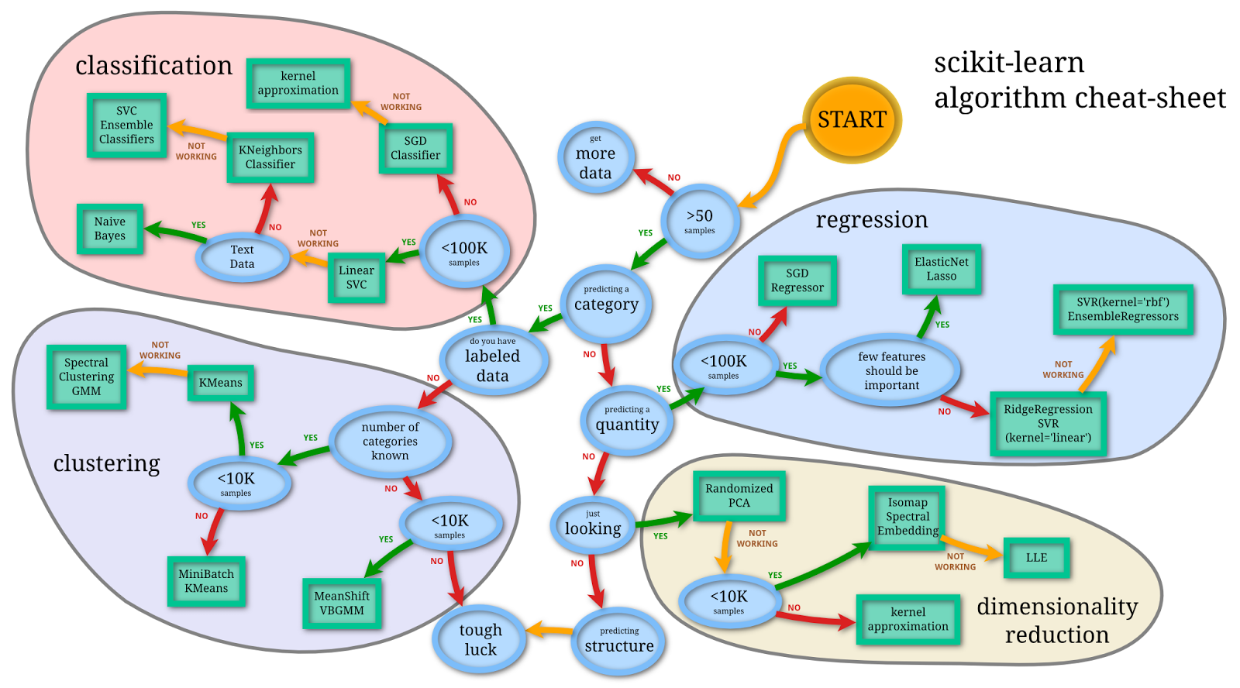
There are a lot of them
But where do we start?

Slide 32
Different machine learning models
Decision trees/random forests for a more robust algorithm
Support vector machine (SVM) for finding non-linear relationships
Principal component analysis (for dimensionality reduction)
From my experience the next best ones to try in general are:

Slide 33
In review
Application of matrix operations for linear regression
Multivariate linear regression
Train test split
Classification
Logistic regression
Performance metrics
Linear and logistic regression

Slide 34
Next lesson
Deep dive into performance metrics
Machine learning model optimisation
Bias/variance
Underfitting/overfitting
L1/L2 regularisation

